Slide 1
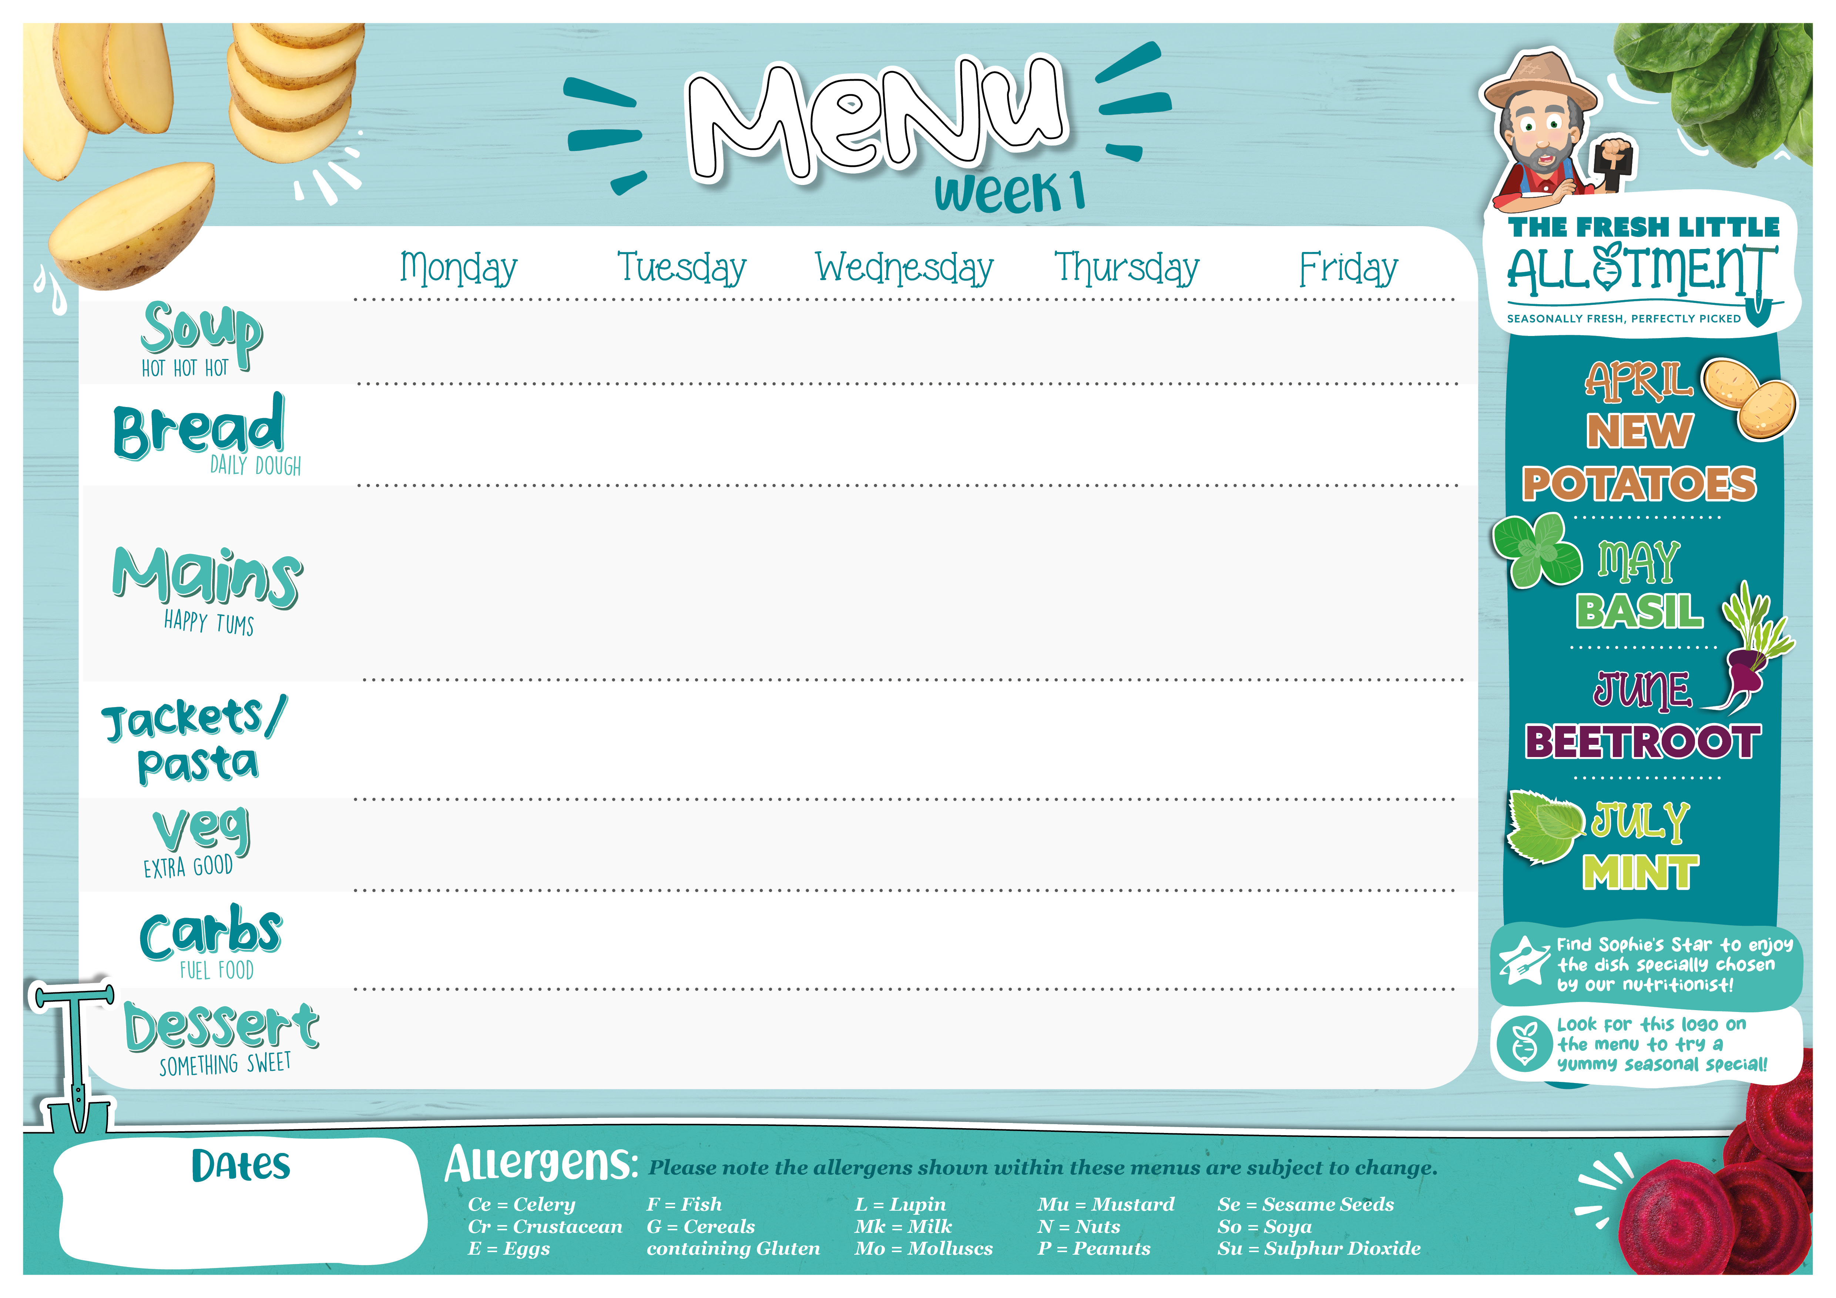


Garden Pea & Fresh Mint | Thai Sweet Potato & Coconut | Chef’s Seasonal Soup Kitchen | Tomato & Basil | Chef’s Seasonal Soup Kitchen
Accent Focaccia (G) | Accent Focaccia (G) | Chef’s Speciality Guest Bread (G) | Accent Focaccia (G) | Accent Focaccia (G)
Moroccan Chicken Tagine with Aubergine & Apricots (G,Su) | Traditional Beef Lasagne with a Cheesy Crust (G,Mk,E) or Lamb Bolognese (G) | Roast Gammon (*Alternative Roast Chicken) with Sage & Onion Stuffing (G) and Rich Gravy | Pasta Kitchen: Choose Your Pasta and Add Your Sauce Creamy Chicken, Bacon & Basil (Mk) Chicken Arrabbiata | Battered Fish (G, F) or Oven Baked MSC Fish with Chunky Tartare Sauce and Lemon Wedges (G,F,E)
(VE) Sweet Potato & Carrot Falafel with Beetroot, Apple & Red Cabbage Salad | Chick Pea & Roasted Summer Vegetable Lasagne (G,E,So) | Quorn Fillets (G) | Plant Rich Sweet Chilli & Halloumi Wrap with Mint Yoghurt Sauce (G,So,Mk) | Egg and Cheddar Frittata with Peppers & Peas (E,Mk)
Pasta with a Tomato Sauce (G) | Jacket Potato With Cheese and Beans (Mk) | Pasta with a Tomato Sauce (G) | Jacket Potato With Cheese and Beans (Mk) | Pasta with a Tomato Sauce (G)
Cauliflower Steamed Green Beans | Steamed Sweetcorn Chef’s Mixed Summer Salad | Parsley Powered Carrots & Beetroot Sauteed Spring Greens | Roasted Broccoli Steamed Green Beans | Minted Garden Peas Baked Beans
Lemon & Mint Scented Couscous (G,So,Mu) | Garlic Focaccia Bread (G) | Skin on Roasted New Potatoes | Penne Pasta (G) Wholemeal Fusilli Pasta (G) | Oven Baked Chips
Yoghurt Pots (Mk) Berry Compote | Vegan Jelly | White Chocolate Chip and Raspberry Cookie (G, Mk, So, E) | Yoghurt Pots (MK) Mango Compote Granola (G) | Vegan Chocolate Brownie (G, So)
20th April, 11th May, 1st June, 22nd June

Slide 2

Potato, Chive & Watercress | Tuscan Spring Vegetable & Bean Minestrone | Chef’s Seasonal Soup Kitchen | Tomato & Roasted Pepper | Chef’s Seasonal Soup Kitchen
Seeded Wholemeal Bloomer (G,Su) | Seeded Wholemeal Bloomer (G,Su) | Chef’s Speciality Guest Bread (G) | Seeded Wholemeal Bloomer (G,Su) | Seeded Wholemeal Bloomer (G,Su)
Korean BBQ Chicken (So,Mu) & Roasted Corn Cobs with a Garlic and Ginger Sauce | Italian Herby Pork or Beef Meatballs (G) in a Rich Tomato & Basil Sauce served with Spaghetti (G) | Roast Chicken with Sage & Onion Stuffing (G) & Rich Gravy | Mexican Lamb Chilli Con Carne with Smashed Avocado, Sour Cream (Mk), Salsa and Tortilla Chips (So) | Oven Baked Battered Fish (G,F) or Oven Baked MSC Fish Fingers (G,F) with Lemon & Parsley Vegan Mayo
(VE) Greek Style Butterbeans in Tomato Sauce with Spinach & Grilled Flat Bread (G) | (VE) Green Summer Vegetable Risotto with Borlotti Beans | Mozzarella Topped Courgette & Aubergine Parmigiana (G,Su,Mk) | (VE) Plant Rich Chilli Sin Carne with Pico de Gallo & Plant Based Sour Cream (G) | (VE) Lightly Spiced Tofu Fajitas with Kale, Tomatoes & Peppers (G,So)
Pasta with a Tomato Sauce (G) | Jacket Potato With Cheese and Beans (Mk) | Pasta with a Tomato and Mascapone Sauce (G,Mk) | Jacket Potato With Cheese and Beans (Mk) | Pasta with a Tomato Sauce (G)
Shredded Asian Lime & Chilli Slaw Smashed Minted Peas | Steamed Broccoli Roasted Leeks | Sauté Seasonal Greens Thyme Roasted Beetroot | Roasted Peppers & Corn Grean Beans | Minted Garden Peas Baked Beans
Sticky Rice | Minted New Potatoes | Skin on Roast Potatoes Garlic Focaccia (G) | Steamed White & Wholegrain Rice | Oven Baked Chips
Banana & Berry Cake (G,E) | Yoghurt Station (Mk) Granola (G) Berry Compote | Eton Mess with Berries and Cream (E,Mk) | Vegan Jelly | Chocolate Sponge with Chocolate Orange Frosting (G,E,Mk)
27th Apr, 18th May, 8th June, 29th June

Slide 3

Sweetcorn & Spring Onion Chowder | Seasonal Vegetable & White Bean | Chef’s Seasonal Soup Kitchen | Roasted Tomato & Oregano | Chef’s Seasonal Soup Kitchen
Beetroot & Caraway Bread (G) | Beetroot & Caraway Bread (G) | Chef’s Speciality Guest Bread (G) | Beetroot & Caraway Bread (G) | Beetroot & Caraway Bread (G)
Chicken Fajitas with Tortilla Wraps (G) | Traditional Beef Bolognaise or Lamb Bolognese (G) with Basil & Cheese (Mk) | Grilled Butchers Pork Cumberland Sausages (G,Su) with Balsamic Onion Chutney (Su) | Mild BBQ Jerk Chicken with Coconut Rice & Peas | Breaded Fish (G,F) or Oven Baked MSC Fish Fingers (G, F) with Chunky Tartare Sauce and Lemon Wedges (G,F,E)
(VE) Lightly Spiced Tofu Fajitas with Kale, Tomatoes & Peppers (G,So) | (VE) Super Lentil, Mushroom & Spinach Bolognaise (G) | Vegan Sausages (G) | Jerked BBQ Jack Fruit (VE) with Coconut Rice & Peas | Roasted Vegetable & Basil Focaccia Pizza (G,Mk)
Pasta with a Tomato Sauce (G) | Jacket Potato With Cheese and Beans (Mk) | Mac & Cheese (G,Mk) Topped with Crushed Nachos (So) & Tomato Salsa | Jacket Potato With Cheese and Beans (Mk) | Pasta with a Tomato Sauce (G)
Skin on Roasted Butternut Squash with Sage Baton Carrot Salad | Steamed Broccoli Roasted Mediterranean Summer Vegetables | Parsley Powered Carrots Steamed Spring Greens Summer Garden Salad | Sweetcorn & Peppers Caribbean Coleslaw | Minted Garden Peas Baked Beans
Mexican Spiced Rice | Penne (G) | Sweet Potato Mash | Coconut Rice & Peas Roti Bread (G) | Oven Baked Chips
Vegan Jelly | Lemon & Lime Drizzle Cake (G,E) | Yoghurt Bar (Mk) Raspberry Compote | Apricot Shortbread (G,Su) | Chocolate Mousse (Mk)
4th May, 25th May, 15th Jun,

