Slide 1
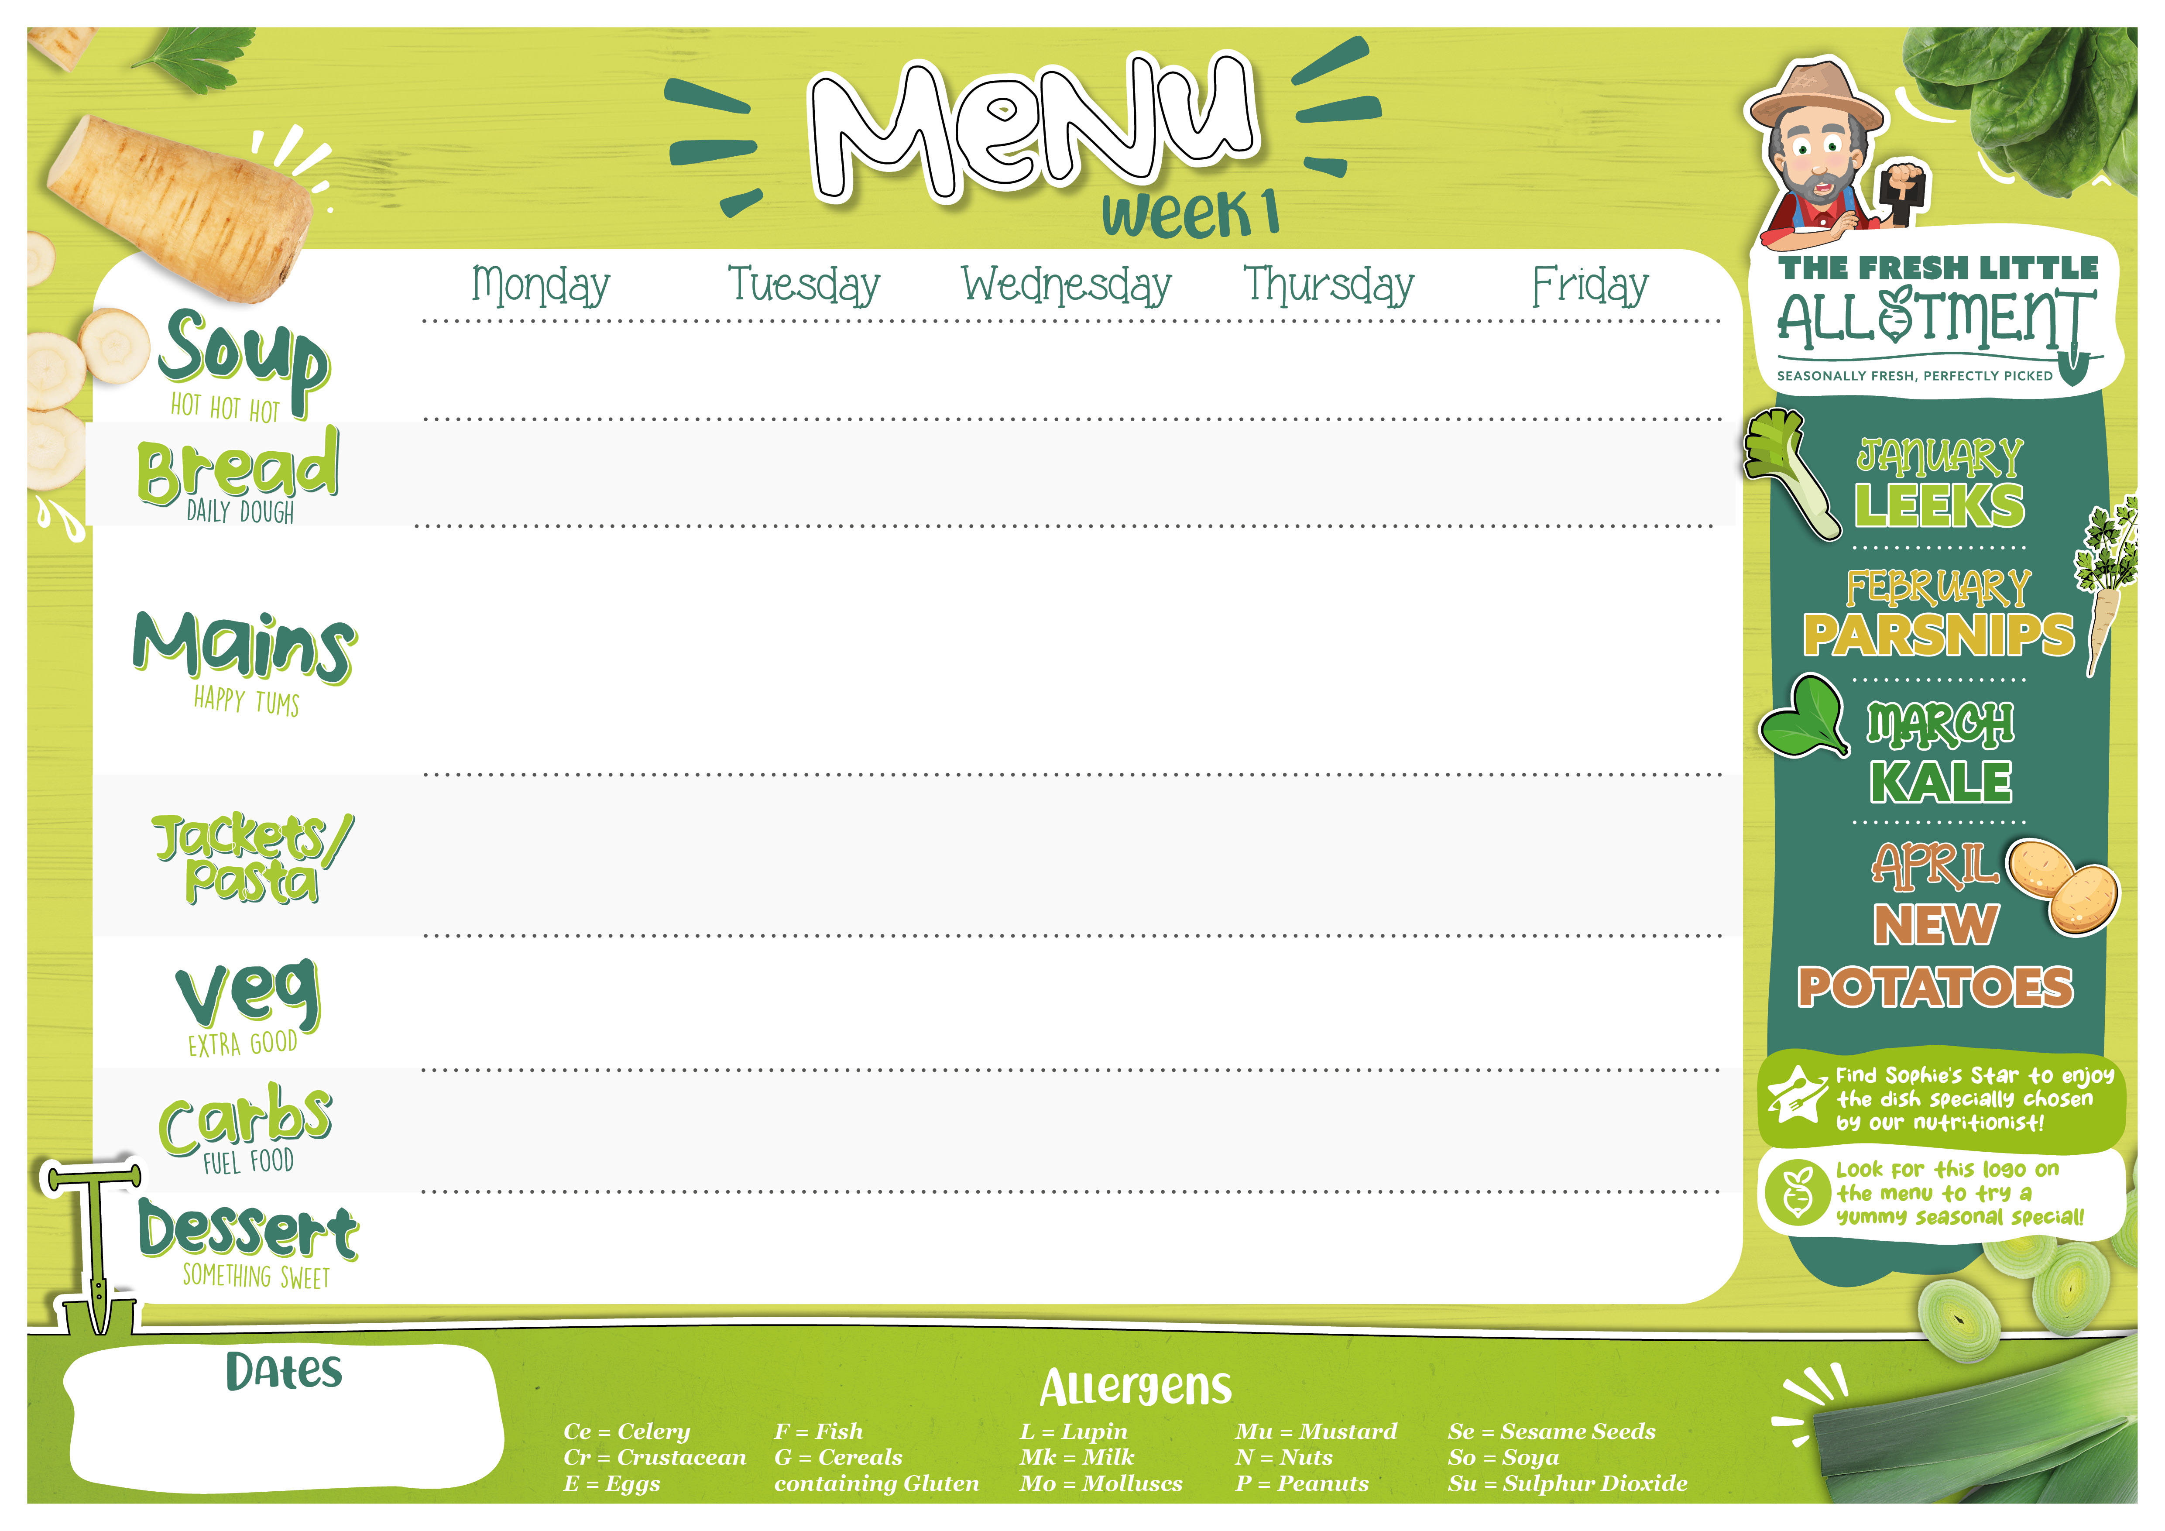


Tomato & Basil | Leek & Potato | Carrot & Coriander | Winter Vegetable | Cauliflower & White Bean
Accent Focaccia (G) | Accent Focaccia (G) | Accent Focaccia (G) | Accent Focaccia (G) | Accent Focaccia (G)
Toad in the Hole with Onion Gravy (G,E,Mk,Su) OR Quorn Toad in the Hole with Onion Gravy (G,E,Mk) | Sticky BBQ Chicken OR Sticky BBQ Eat Curious Pieces | Turkey & Sweetcorn Pie (G,Mk) OR Seasonal Vegetable & Lentil Wellington (G,Mk) | Mild Beef Chilli Con Carne OR Eat Curious Smoky Veggie Chilli | Fish Fingers (G,F) or Battered Fish with Lemon Wedges Vegan Tartare Sauce OR Leek & Cheddar Quiche (G,E,Mk)
Pasta (G) with a Tomato Sauce | Jacket Potato with Cheese (Mk), Baked Beans or Tuna Mayonnaise (F) | Pasta (G) with a Tomato Sauce | Jacket Potato with Cheese (Mk), Baked Beans or Tuna Mayonnaise (F) | Macaroni Cheese (G,Mk)
Steamed Green Beans Parsley Carrots | Steamed Sweetcorn Cauliflower Florets | Green Cabbage & Kale Honey & Thyme Roast Root Vegetables | Steamed Broccoli Sauteed Courgettes | Garden Peas Baked Beans
Colcannon Mash (Su) | White & Wholegrain Rice | Skin on Roasties | Steamed Rice | Oven Baked Chips OR Steamed New Potatoes
Hand Cut Fruit Pots Greek Yoghurt Station (Mk) | Chocolate Rice Pudding Pots (Mk) | Vegan Jelly Pots | Hand Cut Fruit Pots Greek Yoghurt Station (Mk) | Banoffee Pots (G,Mk)
5 Jan, 26 Jan, 16 Feb,
9 March

Slide 2

Parsnip & Carrot | Farmhouse Leek & Potato | Sweet Potato | Roasted Carrot & Thyme | Creamy Sweetcorn (Mk)
Bloomer (G) | Bloomer (G) | Bloomer (G) | Bloomer (G) | Bloomer (G)
Mild Chicken Balti with Peppers & Spinach OR Chickpea, Roasted Veg & Coriander Masala | Slow Cooked Lamb Ragu OR Mushroom, Spinach & Lentil Lasagne (G,Mk,E) | Mexican Beef Tacos with Sour Cream (Mk) & Grated Cheddar (Mk) OR Buffalo Bean & Vegetable Tacos with Sour Cream (Mk) & Grated Cheddar (Mk) | Lemon & Herb Chicken with Sage & Onion Stuffing (G) and Gravy OR Roasted Vegetable Filo Tart (G,E,Mk) | Fish Fingers (G,F) or Battered Fish with Lemon Wedges Vegan Tartare Sauce OR Spanish Tortilla (E,Mk)
Pasta (G) with a Tomato Sauce | Jacket Potato with Cheese (Mk), Baked Beans or Tuna Mayonnaise (F) | Pasta (G) with a Tomato Sauce | Jacket Potato with Cheese (Mk), Baked Beans or Tuna Mayonnaise (F) | Pasta (G) with a Tomato Sauce
Steamed Broccoli Roasted Cauliflower | Steamed Sweetcorn Curley Kale | Smoky Roasted Corn Steamed Green Beans | Honey Glazed Carrots Steamed Spring Greens | Minted Garden Peas Baked Beans
Steamed Rice | Penne Pasta (G) | Steamed Rice | Skin on Roast Potatoes | Baked Oven Chips OR Steamed New Potatoes
Hand Cut Fruit Pots Greek Yoghurt Station (Mk) | Apple Crumble Pots (G,Mk) | Vegan Jelly Pots | Hand Cut Fruit Pots Greek Yoghurt Station (Mk) | Berry Cheesecake Pots (G,Mk)
12 Jan, 2 Feb, 23 Feb, 16 March

Slide 3

Sweet Potato | Roasted Pepper & Cannellini Bean | Leek & Chive | Chunky Country Vegetable | Carrot & Parsley
Accent Focaccia (G) | Accent Focaccia (G) | Accent Focaccia (G) | Accent Focaccia (G) | Accent Focaccia (G)
Pork or Vegan Meatballs in a Rich Tomato Sauce (G) OR Roasted Vegetable & Cannellini Bean Stew | Crispy Katsu Chicken with Mild Curry Sauce (G,So) OR Crispy Tofu Katsu (G,So) with Mild Curry Sauce | Classic Lamb Shepherd’s Pie OR Shepherdess Pie topped with S Sweet Potato | Sweet and Sour Chicken Stir Fry (G,So) OR Cauliflower Popcorn Bites with a Sweet & Sour Sauce (G,So) | Fish Fingers (G,F) or Battered Fish, Lemon Wedges & Vegan Tartare Sauce OR Fishless Fingers, Tartare Sauce & Lemon (G,So)
Pasta (G) with a Tomato Sauce | Jacket Potato with Cheese (Mk), Baked Beans or Tuna Mayonnaise (F) | Macaroni Cheese (G,Mk) | Jacket Potato with Cheese (Mk), Baked Beans or Tuna Mayonnaise (F) | Pasta (G) with a Tomato Sauce
Roasted Root Vegetables Steamed Kale | Steamed Broccoli Sauteed Leeks | Honey Glazed Parsnips Steamed Carrots | Broccoli Stir Fried Vegetables | Minted Garden Peas Baked Beans
Fusilli Pasta (G) | Steamed Rice |  | Steamed Chop Suey Noodles (G) | Baked Oven Chips OR Steamed New Potatoes
Hand Cut Fruit Pots Greek Yoghurt Station (Mk) | Peach Melba & Cream Crumble Pots (G,Mk) | Hand Cut Fruit Pots Greek Yoghurt Station (Mk) | Vegan Jelly Pots | Lemon & Thyme Shortbread (G)
19 Jan, 9 Feb, 2 March, 23 March

