Slide 1
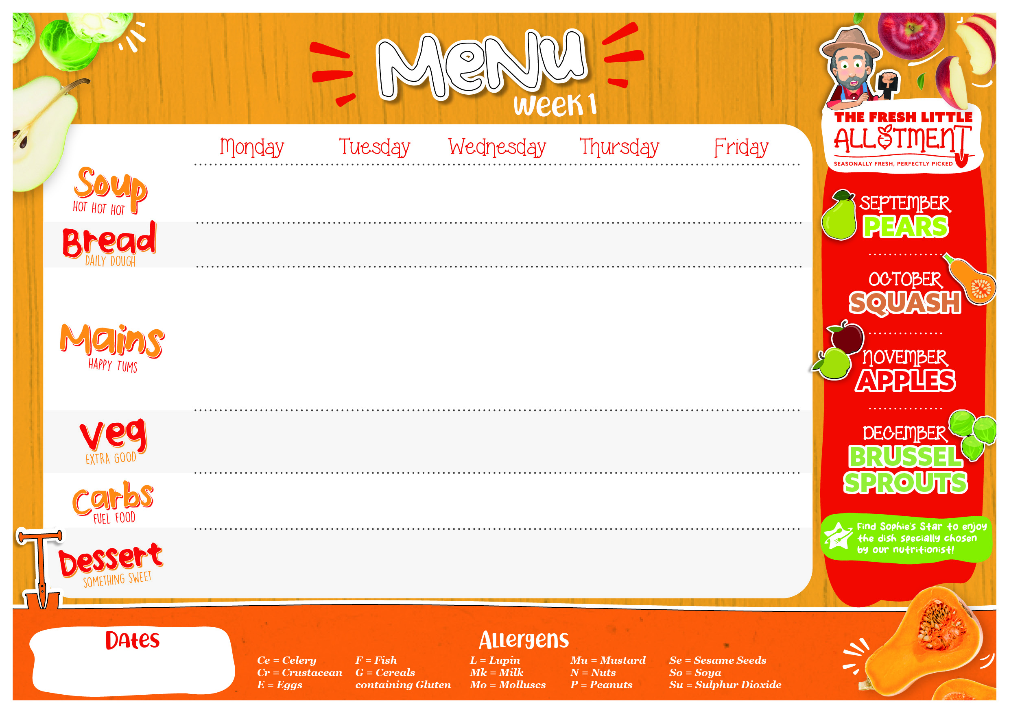


Roasted Tomato | Pea and Mint Soup | Leek and Carrot Soup | Roasted Pumpkin | Carrot Soup
Accent Bloomer (G) | Accent Bloomer (G) | Accent Bloomer (G) | Accent Bloomer (G) | Accent Bloomer (G)
Mild Coconut Chicken Curry | Lamb Bolognaise | Herby Roast Chicken with Gravy | Mexican Beef Chilli Con Carne (G) | Battered Fish (G,F) or Cod Fingers (G,F) with Chunky Tartare Sauce (E) & Lemon Wedges
VEGAN Mild Sweet Potato & Vegetable Curry | VEGAN Bolognaise (G) | Seasonal Autumn Hero - Butternut Squash – Cheese, Leek and Butternut Squash Pie (G,Mk) | Quorn and Vegetable Chilli (C,Eg) Soured Cream (Mk) and Avocado | Seasonal Autumn Hero - Butternut Squash - VEGAN Butternut Squash & Chickpea Stew with Lemon and Coriander Couscous (G)
Corn on the Cob | Sweetcorn | Sticky Honey Carrots | Broccoli | Garden Peas
Roasted Vegetables | Green Beans | Sautéed Autumn Greens | Sweetcorn | Baked Beans
White & Wholegrain Coconut Rice (Su) | Penne (G) | Skin on Roasties | White and Wholegrain Rice | Seasoned Fries
Yoghurt (Mk) and Fruit Bar with Tasty Toppings Crushed Meringue (E) Crumbled Flapjack (G) Berry Compote | Seasonal Autumn Hero - Apples - Apple Crumble (G) Custard (G,So,Mk,E) | Yoghurt (Mk) and Fruit Bar with Tasty Toppings Crushed Meringue (E) Crumbled Flapjack (G) Berry Compote | Fruity Vegan Jelly Pots | Carrot and Apple Muffins (G,E)
WC 01/09/2025, 22/09/2025, 13/10/2025, 03/11/2025, 24/11/2025, 15/11/2025

Slide 2


Carrot & Coriander Soup | Tomato & Basil | Red Pepper and Sweet Potato | Parsnip and Carrot | Little Chefs Seasonal Soup Kitchen
Accent Focaccia (G) | Accent Focaccia (G) | Accent Focaccia (G) | Accent Focaccia (G) | Accent Focaccia (G)
Slow Lamb Keema Curry & Rice | Italian Beef Tomato Lasagne (G,Mk,E) | Chicken and Sweetcorn Puff Pastry Pie (G,Mk) | Margarita Focaccia Pizza (G,Mk) | Battered Fish or Cod Fish Fingers (G,F) with Chunky Tartare Sauce (E) and Lemon Wedges
VEGAN Cauliflower, Potato & Chickpea Curry | Roasted Pepper and Tomato Pasta (G) | Butternut Squash & Chickpea Stew | Baked Gnocchi in a Roasted Vegetable Tomato Sauce Topped with Melting Mozzarella (G,So,Mu,Mk,E) | Cheese & Baked Bean Patties (G,Mk)
Sweetcorn | Steamed Broccoli | Roasted Carrots | Steamed Green Beans | Garden Peas
Steamed Leeks | Accent House Salad | Cauliflower | Rainbow Slaw Vegan Mayonnaise | Baked Beans
White and Wholegrain Rice | Home Made Garlic Bread (G,Mk) | Creamy Mash (Su) | Baked Potato Wedges | Baked Oven Chips
Naan Bread Fingers (G)
Yoghurt (Mk) and Fruit Bar with Tasty Toppings Shortbread Crumble (G) Honey Drizzle | Dairy Free Orange Poppy Seed Muffins (G,E) | Yoghurt (Mk) and Fruit Bar with Tasty Toppings Shortbread Crumble (G) Honey Drizzle | Seasonal Autumn Hero Apples – Eves Pudding with Vanilla Sauce (G,So,Mk,E) | Fruity Vegan Jelly Pots
WC 08/09/2025, 29/09/2025, 20/10/2025, 10/11/2025, 01/12/2025, 22/12/2025

Slide 3

Sweet Potato Soup | Leek and Carrot Soup | Chunky Farmhouse Leek and Potato | Roasted Pumpkin | Little Chefs Seasonal Soup Kitchen
Wholemeal Bloomer with Pumpkin Seeds (G) | Wholemeal Bloomer with Pumpkin Seeds (G) | Wholemeal Bloomer with Pumpkin Seeds (G) | Wholemeal Bloomer with Pumpkin Seeds (G) | Wholemeal Bloomer with Pumpkin Seeds (G)
Cumberland Sausages or Veggie Sausages with Gravy (G,Ce) Caramelised Balsamic Onion Chutney (Su,Mu) | Braised Beef & Root Vegetable Stew (G) | Spaghetti Carbonara with Bacon (G,Mk) | Thai Green Chicken Curry R06123 | Battered Fish or Cod Fish Fingers (G,F) and Lemon Wedges
 |  |  |  | Oven Baked Salmon & Broccoli Frittata (Mk,F,E) R06736
 | Seasonal Autumn Hero Butternut Squash – Accent Signature “Squashage” Roll (G,Mk,E) with Herby Gravy | Spaghetti in a Rich Tomato Sauce (G) R00374 | Mozzarella and Tomato Quesadilla (G,Mk) served with Coleslaw (E) | VEGAN Chinese Vegetable Spring Rolls with Sweet & Sour Sauce (G,So)
Roasted Cauliflower | Crushed Carrot& Swede | Garden Salad | Sauté Savoy Cabbage | Garden Peas
Corn on the Cob | Steamed Broccoli | Steamed Mixed Vegetables | Steamed Carrots | Baked Beans
Hand Cut Wedges | Focaccia Bread (G) | Colcannon Mash (S) | Zesty Lime Rice | Baked Oven Chips
Seasonal Autumn Hero Apples - Apple & Raspberry Fool Pots (Mk) | Seasonal Autumn Hero - Pears - Pear Strudel Vanilla Sauce (G,So,Mk,E) | Yoghurt (Mk) and Fruit Bar with Tasty Toppings Shortbread Crumble (G) Honey Drizzle | Rocky Road (G,Mk,So) | Seasonal Autumn Hero -- Butternut Squash – Butternut Squash Muffin (G,E) Creamy Topping (Mk)
WC 15/09/2025, 06/10/2025, 27/10/2025, 17/11/2025, 08/12/2025

